Slide 1

CYBERSECURITY AWARENESS
Think before !
you Click , Share & Act
Stay alert • Protect your identity • Help others stay safe
Presentation by:
Shri Anil Verma
Joint Director-(I.T.)
NIC- DNH & DD

Slide 2
Why We Are Here?
The Digital Landscape:
Human Factor: Over 85% of corporate cyber breaches involve a human element.
The Cost: Data breaches cost organizations millions and damage long-term reputation.
Personal Impact: Cyber safety affects your personal identity, finances, and privacy.
Today's Goal: Learn to spot red flags, secure your identity, and report incidents.

Slide 3
What you’ll learn today
RECOGNISE
PROTECT
RESPOND
Spot phishing, scams, fake apps and social engineering.
Use safer passwords, MFA, device settings and Wi‑Fi habits.
Know what to do quickly if an account or device is compromised.
Opening question: “What’s one online risk you or a friend has encountered?”

Slide 4
The Foundation: CIA Triad
Understanding What We Protect:
  Confidentiality: Ensuring only authorized users have access to sensitive data.
  Integrity: Guaranteeing that information is trustworthy, accurate, and untampered.
  Availability: Assuring that systems and data are reliably accessible when needed.
Our Responsibility: Maintain balance across all three pillars daily.

Slide 5

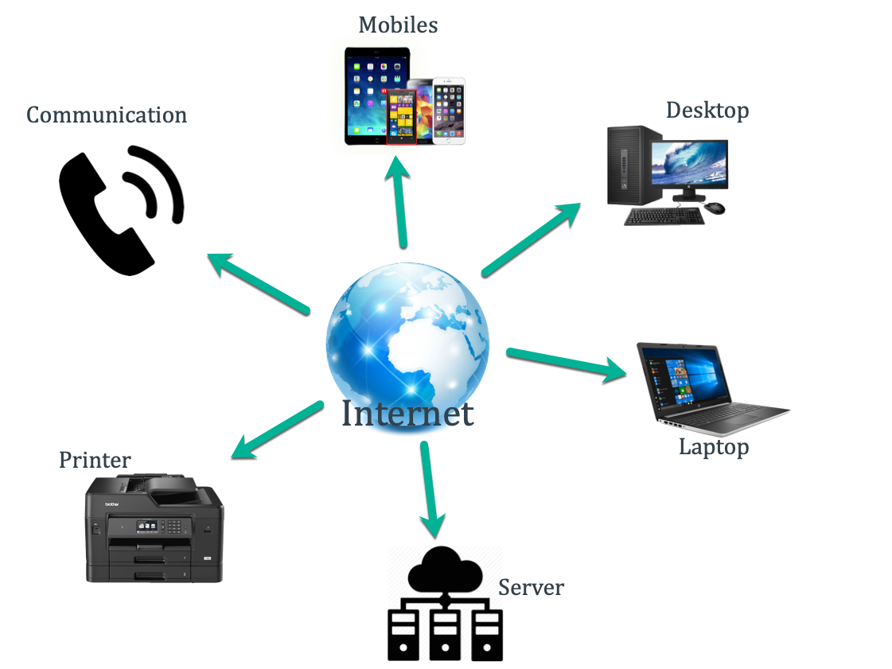
What is Internet
Internet is basically network of networks that connects billions of devices worldwide
It's kind of library, where you can find almost anything you're looking for

Slide 6
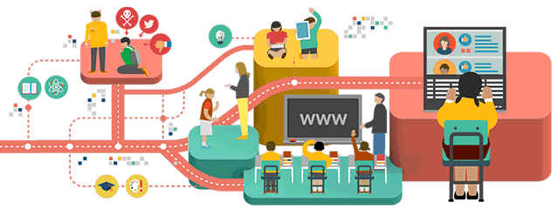
Places where Internet is used
Home
School
Office
Malls
Driving
Banks
In today’s world, we depend on Internet at home, in officers for doing several activities

Slide 7
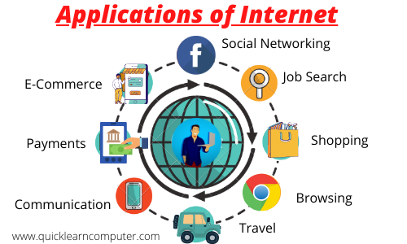
Use of Internet in our Day-to-Day life

Slide 8
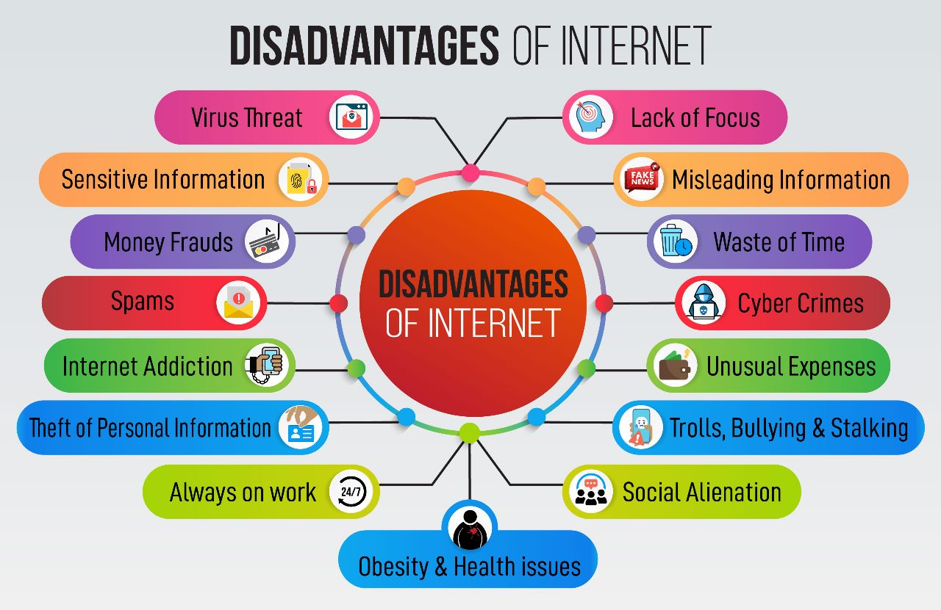

Slide 9
Your digital life is part of your real life
Every post, login, download and shared file creates a trail.
IDENTITY
ACCESS
REPUTATION
Email, phone number, student ID, photos and location.
Social accounts, learning portals, cloud drives and banking.
Old posts, public profiles, screenshots and forwarded messages.
Rule: share deliberately. “Private” settings reduce exposure; they don’t eliminate it.

Slide 10
The threats students commonly face
Phishing
Account takeover
Malicious downloads
Fake emails, DMs, QR codes and login pages
Password reuse, stolen sessions, SIM-swap attempts
Cracked software, fake notes/apps, unsafe extensions
Privacy abuse
Financial scams
AI-enabled deception
Doxxing, impersonation, image misuse, oversharing
Fake internships, scholarship fees, marketplace fraud
Convincing fake voices, images and messages

Slide 11
Phishing (SMS/Email/WhatsApp)
Phishing
Fake messages that look official and ask you to click links.
Goal: steal passwords, card details, banking login.
Signs: urgent tone, unknown links, spelling mistakes.
Safe action: verify on official website/app; don’t click.
  A “required action” as a part of a system or quota upgrade
  A “required action” to prevent email account closure
  A “trusted” vendor, such as a fake Dropbox or Google alert
  A “legitimate” banking alert

Slide 12
Phishing: pause before you trust
A message may look official and still be designed to steal access or money.
RED FLAGS
SAFER RESPONSE
• Urgent threat: “Your account closes today”
• Unexpected attachment or QR code
• Sender address or domain is slightly wrong
• Request for OTP, password or payment
• Link destination doesn’t match the claimed site
• Don’t click or reply in a hurry
• Open the official app/site yourself
• Verify through a separate trusted channel
• Report the message; block the sender
• If unsure, ask campus IT or a trusted adult
Remember: a padlock/HTTPS means the connection is encrypted—not that the site is honest.

Slide 13
Quick exercise: would you click?
COLLEGE IT SUPPORT
A
Subject: Urgent — Student account will be disabled
“Your mailbox is full. Verify your password and OTP within 30 minutes to avoid suspension.”
[VERIFY ACCOUNT]
Click immediately
B
Check official portal separately
C
Forward to friends
Discuss: what are the warning signs? What would you do first?

Slide 14
Examples of Phishing Websites
Phishing Websites
Legitimate Websites
www.gmai1.com
www.icici6ank.com
www.bank0findia.com
www.yah00.com
http://gmail.com
https://www.icicibank.com
https://bankofindia.co.in
https://yahoo.com

Slide 15

Vishing - Phone calls made by fraudsters to steal your personal information and sensitive information
- they communicate
as bank officer
referring your shopping

Slide 16


Smishing- SMS + Phishing. It is a cyberattack in which criminals send fake text messages to trick people into clicking malicious links, sharing sensitive information, or making payments.

Slide 17
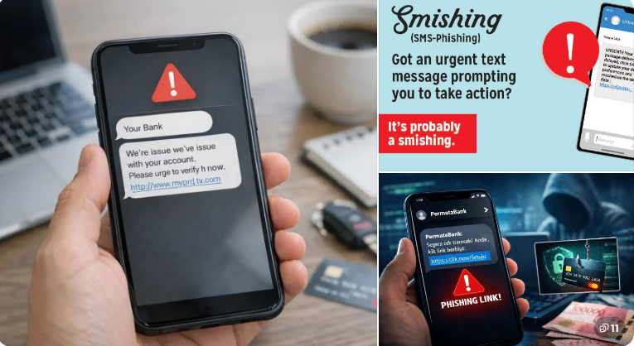
Smishing- SMS + Phishing. It is a cyberattack in which criminals send fake text messages to trick people into clicking malicious links, sharing sensitive information, or making payments.

Slide 18
Smishing-
1. Attacker sends a fraudulent SMS
2. Victim clicks the link or calls a fake number
3. Victim reveals credentials, OTP, or payment details
4. Attacker may steal money or take over an account
Video Link
Financial Fraud - Vishing/Phising Smishing

Slide 19
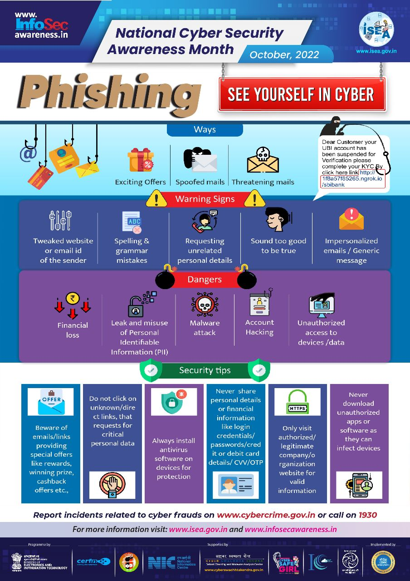

Slide 20
Social engineering: hacking the human
Social Engineering: Hacking the Human — Definition, how attacks work, and the emotions attackers exploit.
Common Techniques — Phishing, smishing, pretexting, baiting, tailgating, and deepfake scams.
Stay Safe: How to Protect Yourself — Practical security measures and an interactive classroom OTP scam activity.
Defence: stop, verify independently, and never share an OTP or recovery code.

Slide 21
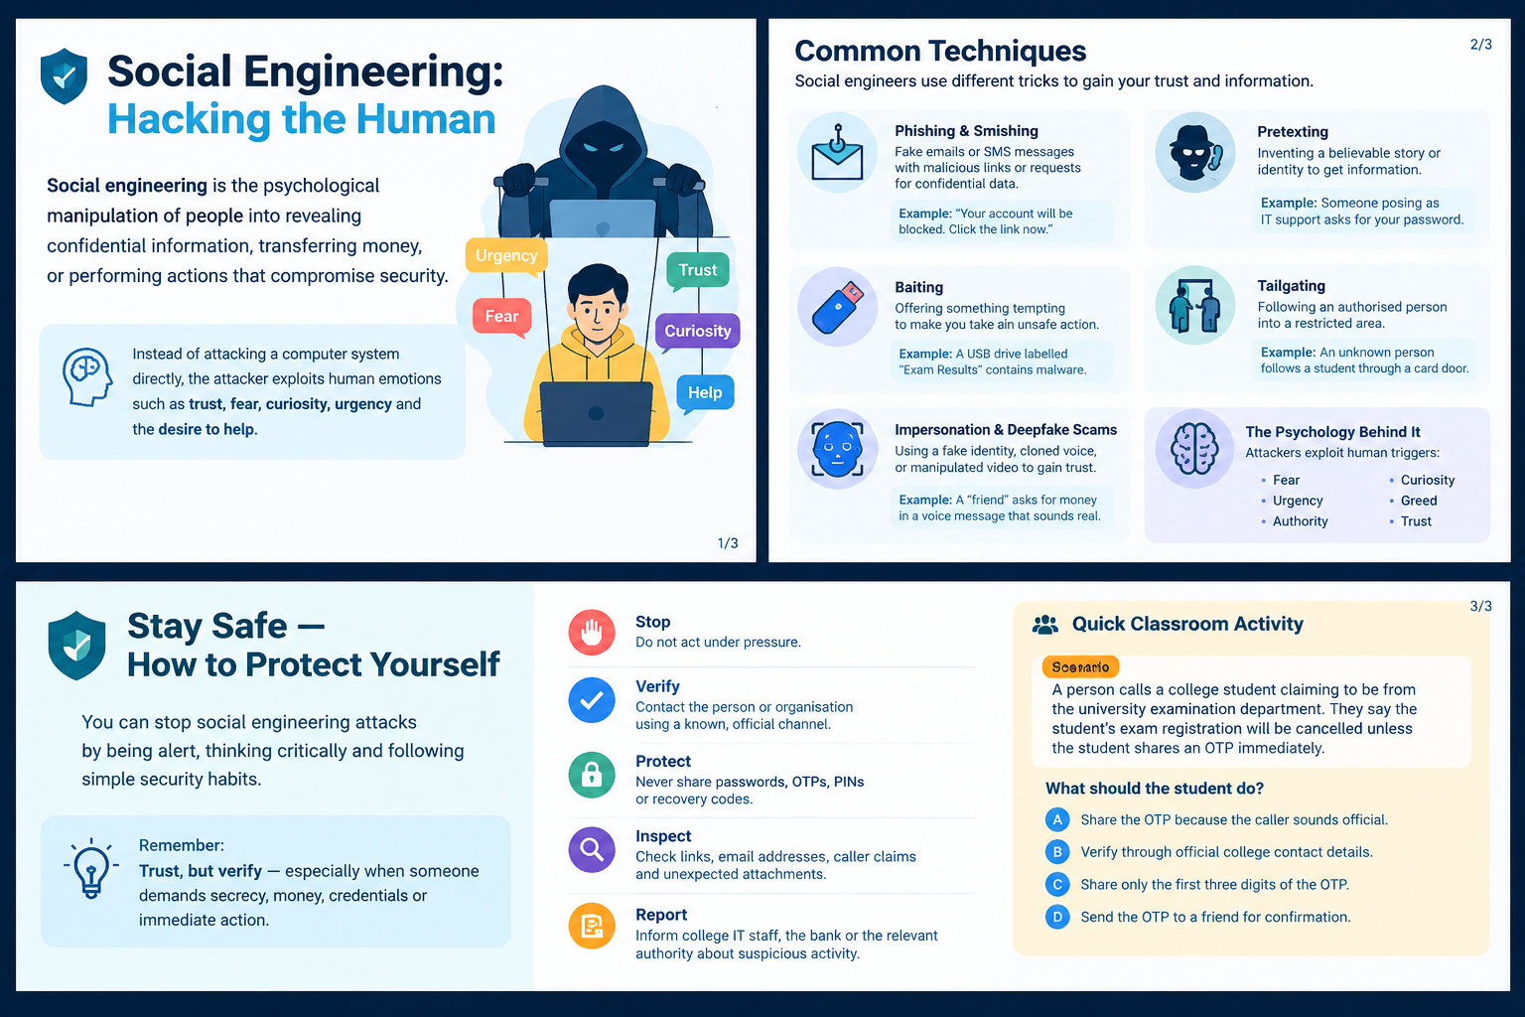
06 / MANIPULATION TACTICS
CYBERSECURITY AWARENESS
07

Slide 22

Identity Theft
Identity theft involves a range of tactics used by cybercriminals to obtain personal information for fraudulent purposes.
  Financial fraud
  Opening unauthorized accounts
  Making purchases
  Committing other crimes

Slide 23
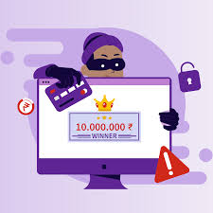
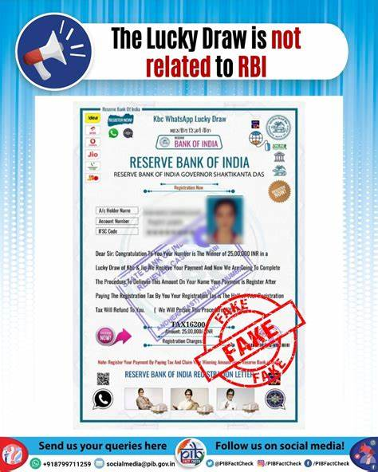
Lottery Scams
Lottery scams prey on excitement, tricking victims into believing they’ve won a huge prize—without ever entering.
Fraudsters send fake emails, messages
Calls claiming you must pay taxes or fees to claim your winnings
They pressure you to act fast, demanding personal and financial details
The truth? Real lotteries never ask for upfront payments
Ignore unsolicited lottery notifications, verify with official sources, and never share sensitive information.

Slide 24
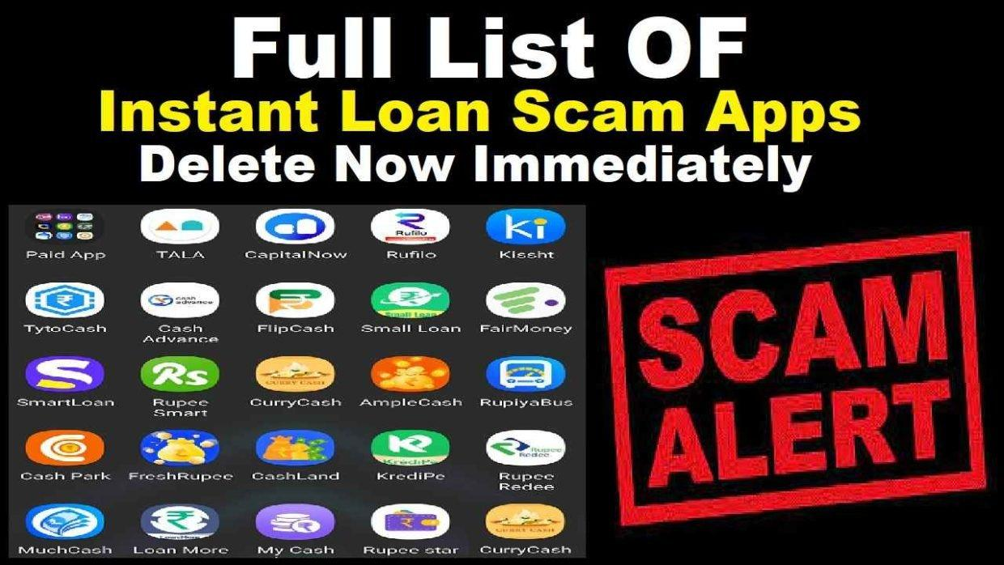
Fake Apps
A fake loan application is a type of financial scam where fraudsters impersonate legitimate financial institutions or lenders and trick individuals into applying for loans under false deceptions.
Malware Installation – Once installed, fake apps may collect personal data, track keystrokes, or install additional malicious software.
Phishing & Scams – Some fake apps prompt users to enter login credentials or payment details, which hackers then steal.

Slide 25

Cyber Hygiene
Training yourself to form good habits around cybersecurity and stay ahead of cyber threats and online security issues.
Cyber hygiene aims to maintain
  Hardware and
  Software's basic health and security,
Cyber hygiene helps to keep data safe and secure.
Help prevent cybercriminals from causing security breaches or stealing personal information.

Slide 26
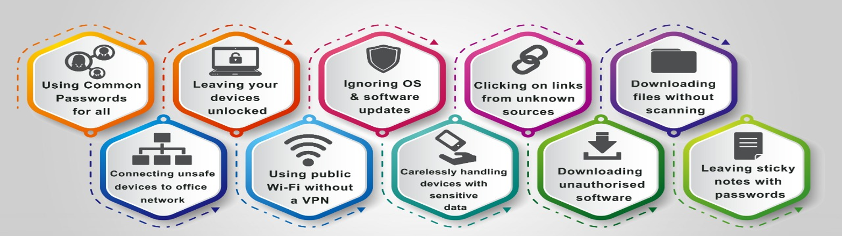
Ten Human Negligence errors that can cause threat to any workplace

Slide 27
Lock down your accounts
UNIQUE PASSWORDS
MULTI-FACTOR AUTH
RECOVERY SAFETY
Use a long, unique passphrase for every important account. A password manager helps you avoid reuse.
Enable MFA—prefer passkeys or authenticator apps where available. Never approve an unexpected prompt.
Secure your recovery email and phone. Save backup codes privately; never share them with anyone.
Priority order: email account → financial accounts → social media → learning/cloud accounts.

Slide 28
Lock down your accounts
Keeping passwords safe and secure
I avoid using the same password for different accounts
I change my passwords on a regular basis
My passwords are at least 12 characters long (and ideally longer)
My passwords involve a mix of upper- and lower-case letters plus symbols and numbers
My passwords avoid the obvious - such as using sequential numbers (“1234”) or personal information that someone who knows me might guess, such as my date of birth or a pet’s name
I avoid writing my passwords down or sharing them with others

Slide 29
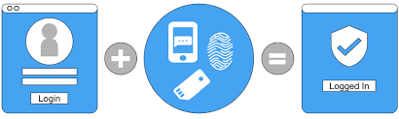
Using multi-factor authentication
All my essential accounts – such as email, social media, or banking apps – are protected with multi-factor authentication (MFA)
more than one form of identity to authenticate a user and approve access

Slide 30
Make your phone and laptop harder to hack
• Install OS, browser and app updates promptly.
• Use a screen lock, device encryption and remote-find/erase features.
• Install apps only from official stores or verified publisher sites.
• Review app permissions; remove apps and browser extensions you don’t use.
• Back up important files; test that you can restore them.
• Avoid cracked software, unknown USB drives and unexpected attachments.
Convenience is useful. Unnecessary access is risk.

Slide 31
Public Wi‑Fi, QR codes and charging stations
PUBLIC WI‑FI
QR CODES & LINKS
USB & CHARGING
• Confirm the network name with staff
• Avoid sensitive transactions on unknown networks
• Turn off auto-join and sharing
• Use your mobile hotspot when practical
• Check the destination before opening
• Be suspicious of stickers placed over codes
• Don’t install apps from a random QR page
• Never enter credentials just because a page looks familiar
• Prefer your own charger and power adapter
• Use a trusted cable or data blocker
• Don’t accept unexpected USB devices
• Choose “charge only” if offered
HTTPS helps protect data in transit, but it does not make every network or website trustworthy.

Slide 32
Protect your privacy and reputation
BE INTENTIONAL
IF YOU’RE TARGETED
• Limit public visibility of personal details
• Disable location sharing when not needed
• Review tagged photos and connected apps
• Think before posting IDs, tickets or schedules
• Ask consent before sharing others’ photos
• Save evidence: URLs, usernames, dates and screenshots
• Block and report the account/content
• Tell a trusted person or campus authority
• Don’t retaliate or pay an extortionist
• Escalate threats, stalking or intimate-image abuse
A screenshot can outlive a post. Share only what you can stand behind.

Slide 33
Protect your privacy and reputation
Don't post private information such as home address, private pictures, phone number, or credit card numbers publicly on social media
Avoid quizzes, games, or surveys on social media that ask for sensitive personal information
Phone locked with a password or PIN
Take care not to disclose private information when using public Wi-Fi
Make sure any online transactions I make are via a secure website – where the URL starts with https:// rather than http:// and there is a padlock icon to the left of the address bar
Share information about online privacy with family and friends to help keep them safe

Slide 34
AI deepfakes and synthetic scams
AI can make fake messages, voices, images and videos more convincing.
DON’T TRUST THE VOICE
VERIFY OUT OF BAND
PROTECT YOUR DATA
A voice note or video call can be impersonated or manipulated.
Call a known number or ask a question only the real person would know—without relying on the suspicious channel.
Don’t upload IDs, private documents or confidential college/work data to untrusted AI services.
If a request involves money, secrecy or urgency, independently verify it.

Slide 35
Digital payments and student scams
UPI SAFETY
COMMON BAITS
IF MONEY IS LOST
• Enter UPI PIN only to authorise a payment
• Receiving money does not require your PIN
• Check recipient name and amount
• Never share screen or OTP with a stranger
• Fake internships or job offers
• Scholarship/registration fees to personal accounts
• Marketplace overpayment and refund tricks
• “Prize won” links and impersonated support
• Contact your bank/payment provider immediately
• In India, call 1930 promptly for cyber financial fraud
• Report at cybercrime.gov.in
• Keep transaction IDs and evidence
Use official contact details—not the phone number or link sent by the suspected scammer.

Slide 36

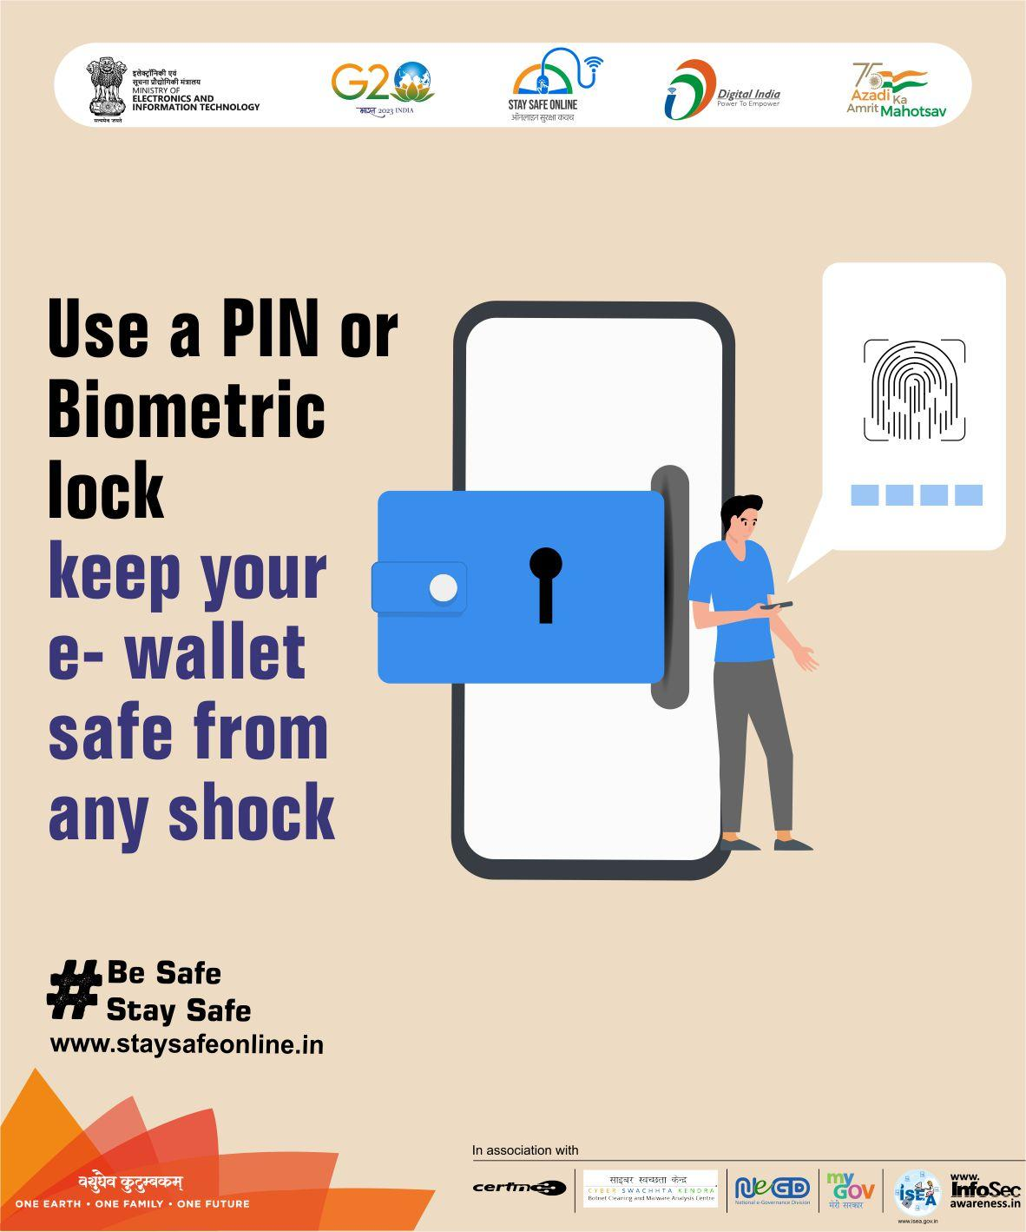
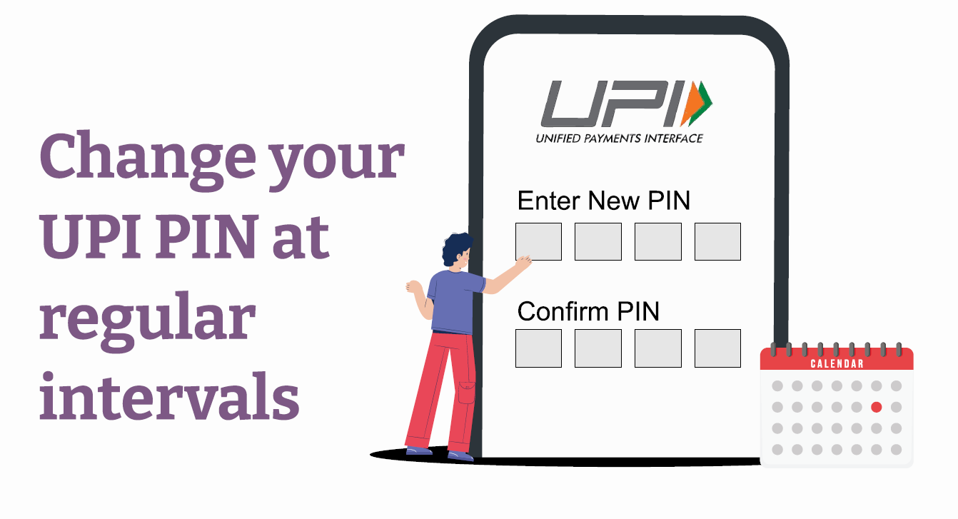
UPI – Best Practices

Slide 37
UPI – Best Practices
Never share your UPI PIN
Do not use easy to guess UPI PIN
Beware of cameras while entering UPI PIN
Use trusted app from trusted source
Ensure using updated app
Avoid using Public Wifi

Slide 38
UPI – Best Practices
How to secure - Credit card and Debit card
Use Strong Passwords
Sign the back of your Card
Be Careful with your Card
Use Two-Factor Authentication
Use Secure Websites
Report Lost or Stolen Cards Immediately
Set Limits

Slide 39
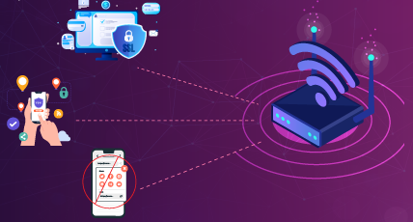
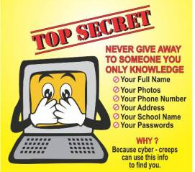
UPI – Best Practices
Public Wi-Fi: Avoid making financial transactions over public Wi-Fi networks.
Personal Info: Be careful about sharing your full name, address, phone number, or financial details online.

Slide 40
SMS-Short Message Service.
Can You Trust Every SMS You Receive?
01
We receive messages from banks, shopping apps, colleges, and unknown numbers.
02
Some messages are genuine, while others may be scams.
03
Today's question: How can we spot the difference?
04

Slide 41
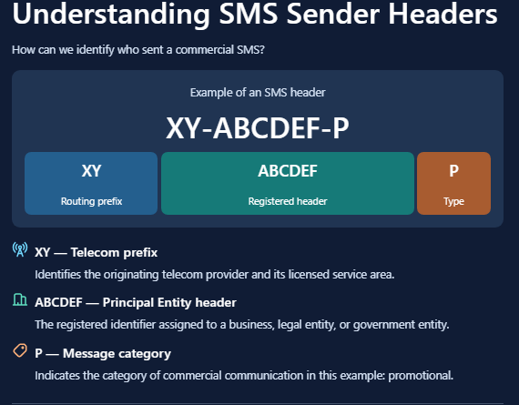

Slide 42
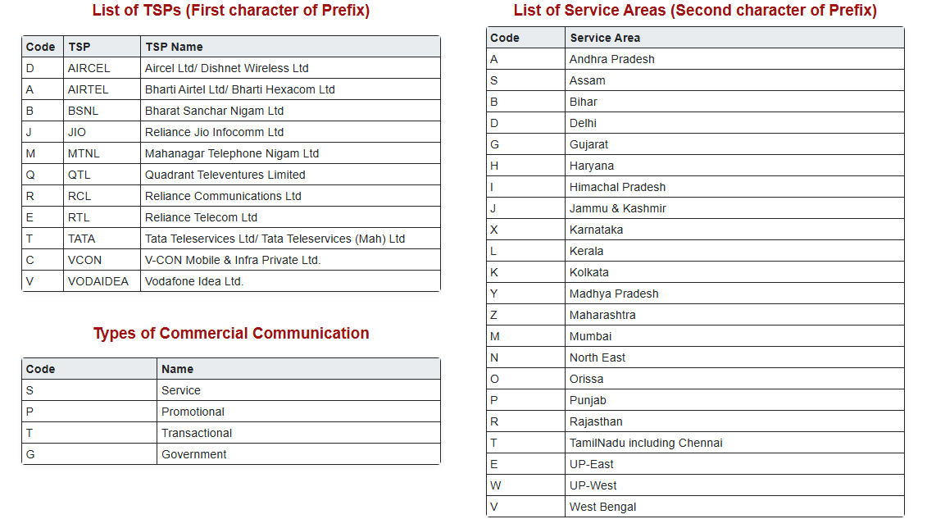

Slide 43
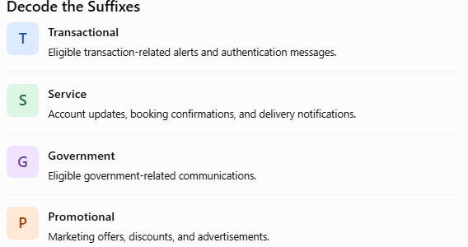
https://smsheader.trai.gov.in/loginpage

Slide 44
Cyber safety on campus
LEARNING PLATFORMS
GROUP CHATS
ETHICAL CONDUCT
Use official LMS links. Sign out on shared computers. Don’t share account access or upload classmates’ data without permission.
Verify urgent announcements with faculty/official channels. Don’t forward unverified warnings, APKs or “free notes” files.
Never access another person’s account, test systems without written permission, or share credentials—even as a joke.
Curiosity is good. Test only in authorised labs and environments.

Slide 45
If you clicked, paid or got hacked: act fast
1
STOP
Stop interacting; don’t send more money or codes.
2
SECURE
From a trusted device, change passwords; revoke sessions and enable MFA.
3
ALERT
Contact bank/platform/campus IT using official channels.
4
PRESERVE
Save messages, URLs, screenshots, transaction IDs and timestamps.
5
REPORT
Report to the relevant platform and official cybercrime channel.
Don’t feel ashamed. Quick reporting can reduce harm and help others.

Slide 46
Has your WhatsApp suddenly logged out? Are you unable to log back in? Your account may have been compromised.. Act Immediately!
1. Disable Call Forwarding Check your call-forwarding settings and contact your mobile operator to disable unauthorized forwarding. The code ##21# commonly disables unconditional call forwarding on GSM networks; codes may vary by operator.
2. Recover Your WhatsApp Account Visit the official WhatsApp Support Page and request help recovering your compromised account.
3. Secure Your Social Media Accounts
Facebook: https://www.facebook.com/hacked
Instagram: https://help.instagram.com/contact/
4. Follow These Safety Measures
Use your registered mobile number and email address for recovery.
Never share OTPs or WhatsApp verification codes with anyone.
Never enable call or SMS forwarding at the request of unknown persons.
5. Report Cyber Fraud Immediately 📞 Call 1930
🌐 Visit: https://cybercrime.gov.in

Slide 47
Massage from Delhi Police
https://www.facebook.com/reel/4518760035019685

Slide 48

CEIR.gov.in is India's official portal for reporting and blocking lost or stolen mobile phones.
🌐 Official website: https://www.ceir.gov.in/
Key services
Block Stolen/Lost Mobile: Block a lost or stolen phone using its IMEI number.
Check Request Status: Track your blocking request.
Unblock Found Mobile: Request unblocking if your phone is recovered.

Slide 49
Where to report and get help in India
NATIONAL CYBER CRIME PORTAL
FINANCIAL CYBER FRAUD
cybercrime.gov.in
Use the official portal to report cybercrime.
Call 1930 promptly if you have lost money to cyber financial fraud; also notify your bank.
CAMPUS SUPPORT
EMERGENCY OR THREATS
Campus IT/helpdesk, faculty mentor, student welfare office or institutional grievance channel.
For immediate danger, threats or stalking, contact local authorities and a trusted person.
Use official websites and verified contact details. Procedures can vary by incident.

Slide 50
Quick knowledge check
1
A caller asks for your OTP to “stop fraud.”
Never share it; hang up and contact the provider independently.
2
A QR code opens a page asking for your college password.
Close it; use the official portal directly and report the link.
3
A friend sends an urgent money request from a new number.
Verify with the friend through a known, separate channel.
4
You reused your email password on a gaming site that was breached.
Change reused passwords, start with email, enable MFA.
Ask students to answer first; reveal the recommended action after discussion.

Slide 51
Your 10-minute cyber safety checklist
• Turn on MFA for email and important accounts
• Replace reused passwords with unique ones
• Update phone, laptop, browser and apps
• Review social media privacy and location settings
• Remove unknown apps/extensions and unused permissions
• Back up important files and confirm recovery options
• Save official bank, platform and cybercrime reporting links
Choose one action to complete before the end of today.

Slide 52
THINK. VERIFY. PROTECT.
Cybersecurity is not just an IT problem.
It’s a daily habit—and a shared responsibility.
Questions & discussion
Key takeaway: Pause when a message creates urgency, secrecy or fear.

Slide 53
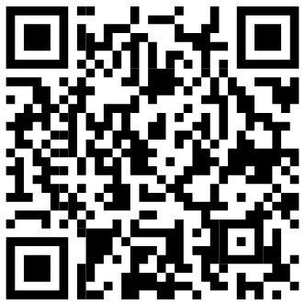
Quick knowledge check
https://nicforms.nic.in/enRhYmxlNmFjZjc3ODY4Mjc4ZTIwMjYxMDE0NA==

Slide 54
Lecturer notes & useful references
References to verify before presenting
• CERT-In: cert-in.org.in
• National Cyber Crime Portal: cybercrime.gov.in
• Cyber Swachhta Kendra: cybercrime.gov.in / official MeitY resources
• CISA: cisa.gov — phishing, MFA and secure accounts
• NIST: nist.gov — digital identity and authentication guidance
Response Link
https://nicforms.nic.in/nicforms_designer/nic_form_response_selector.php?form_id=enRhYmxlNmFjZjc3ODY4Mjc4ZTIwMjYxMDE0NA==
Presenter tip: replace examples with campus-specific reporting contacts and policies.

